Slide 1
Precursory Signatures of Brittle Fracture Growth
Harsha Vora

Slide 2
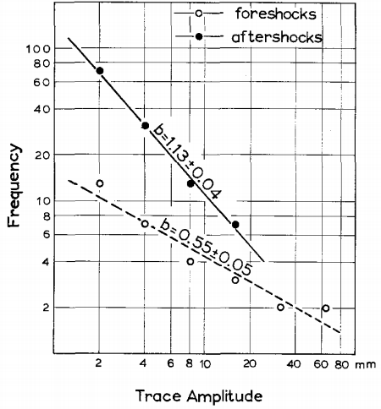
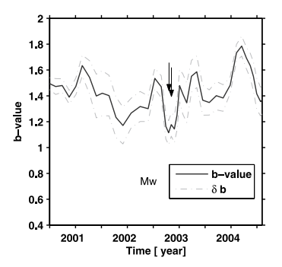
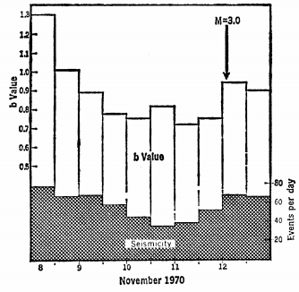
b-value as earthquake precursor
Japan
Indonesia
Alaska
Scholz et al., 1973
Nuannin et al., 2005
Suyehiro, 1966
Several earthquake sequences show a decline in b-values prior to the mainshock

Slide 3
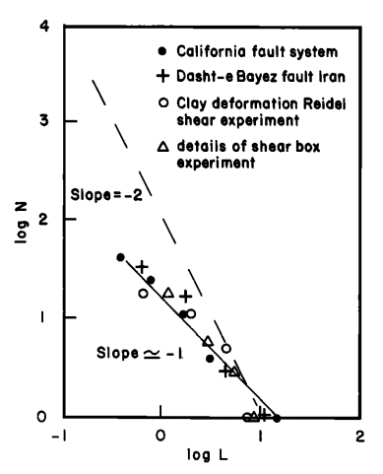
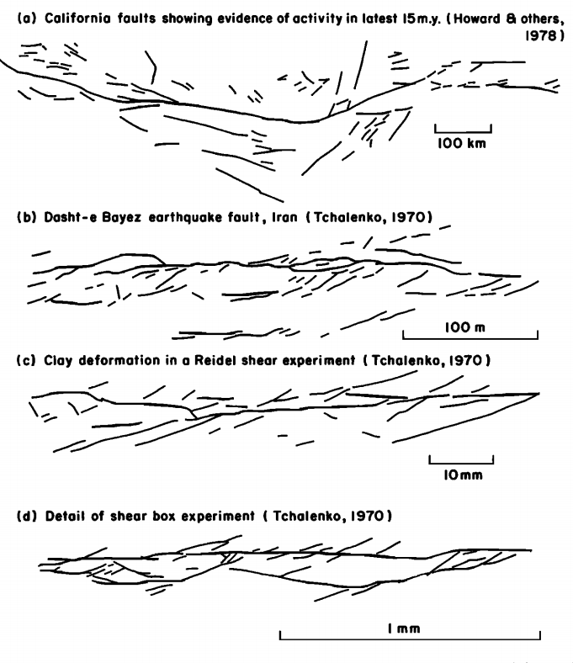
Scale Independence of deformation patterns
Deformation and b-value are scale independent
Can we can use scale-independent statistical tools to predict deformation:
formation of fractures
Slip along faults
Main, 1996

Slide 4
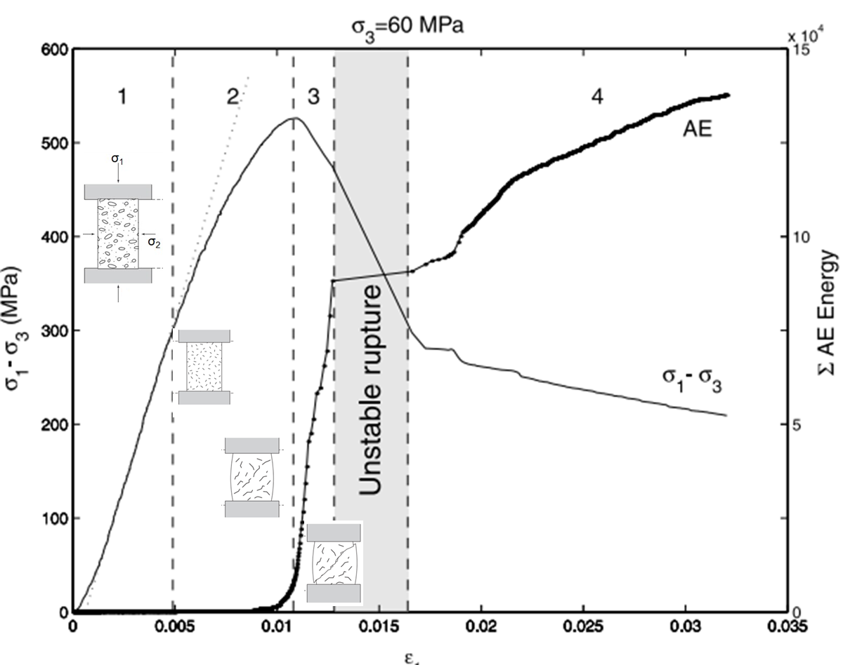
Growth of fractures in Biaxial Experiment
(Modified from Amitrano, 2003)

Slide 5
Motivation
Can we observe precursory signatures of failure on the lab scale through confined experiments?
Are they scale independent?
Can we relate the precursory signatures to micromechanics of deformation?

Slide 6
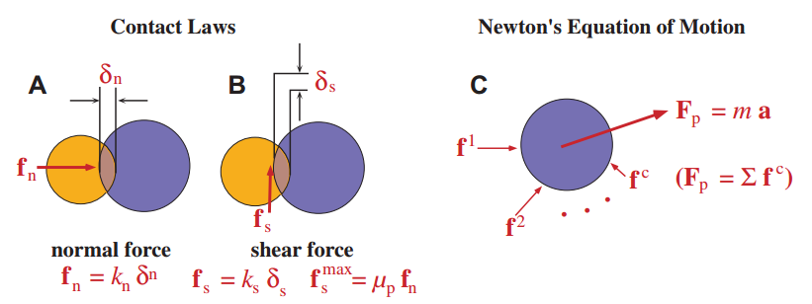
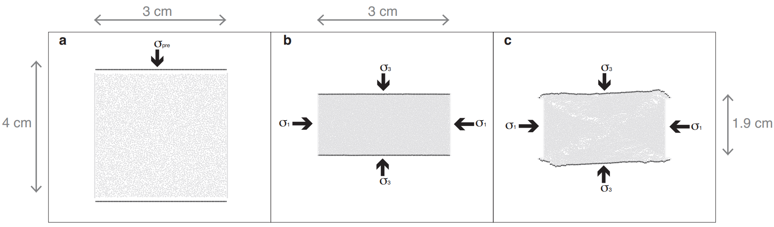
Biaxial tests using Discrete Element Method
Bonds can break in
Tensile
Shear
Rotation

Slide 7
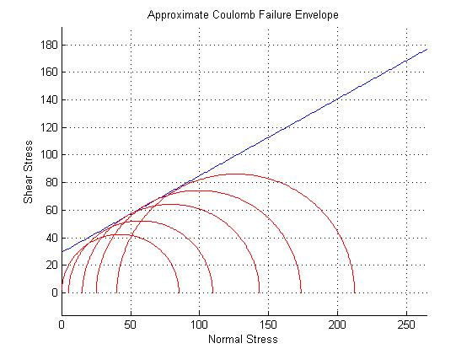
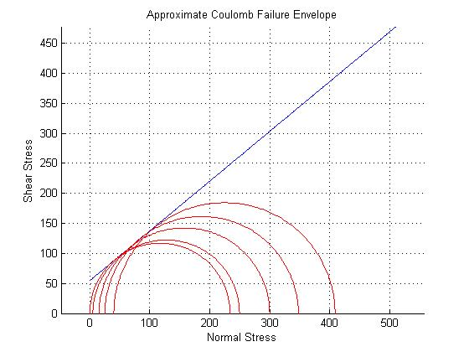
Calibration of DEM Samples
Micromechanical Parameter | Berea Sandstone | Lac du Bonnet Granite
Young’s Modulus of Bonds (E_{b}) Pa | 5.00x10⁹ | 5.00x10¹⁰
Shear Modulus of Bonds (G_{b}) Pa | 5.00x10⁹ | 5.00x10¹⁰
σ_{c}/σ_{t} | 1.00x10¹ | 2.00x10¹
Tensile Strength of Bonds (T_{b}) Pa | 9.00x10⁶ | 6.00x10⁸
Cohesion of Bonds (C_{b}) Pa | 9.00x10⁷ | 1.20x10¹⁰
Shear Modulus of Particles (G_{p}) Pa | 2.90x10¹⁰ | 2.00x10¹²
Poisson’s Ratio of Particles (ν_{p}) | 0.33 x10⁰ | 0.26 x10⁰
Interparticle friction (f) | 0.40 x10⁰ | 0.70 x10⁰
Sandstone
Granite
Scholtès and Donzé, 2013
Macromechanical Property | Model Values for Berea Sandstone | Actual Values for Berea Sandstone | Model Values for Lac du Bonnet Granite | Actual Values for Lac du Bonnet Granite
Unconfined Compressive Strength (UCS) MPa | 85.05 | 95.00¹ | 233.79 | 224.00³
Young’s Modulus (E) GPa | 3.28 | 8.00¹ | 42.47 | 50.00³
Mohr-Coulomb Cohesion (C) MPa | 29.35 | 26.10² | 54.60 | 46.00³
Mohr Coulomb Slope (µ) | 0.55 | 0.49² | 0.83 | 1.05³
¹Bobich, 2005 ²Schellart, 2000 ³Martin and Chandler, 1994

Slide 8
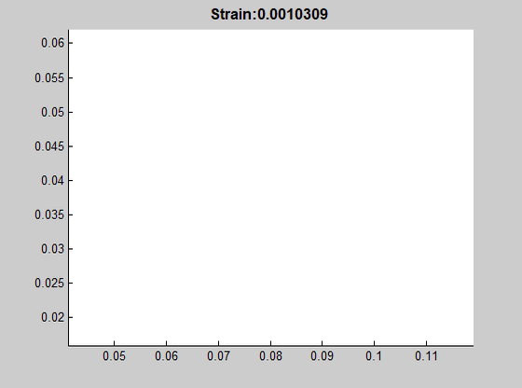

Two Point Fractal Dimension (D-value)
Methods #1
D is the fractal dimension,
N is the number of micro-fracture pairs
R is the radius
Correlation Integral
$$C\left(R\right)=\frac{2}{N\left(N−1\right)} N_{(r<R)}$$
$$C\left(R\right) α R^{D}$$
High D-value: Distributed Damage
Low D-value: Localized Damage

Slide 9
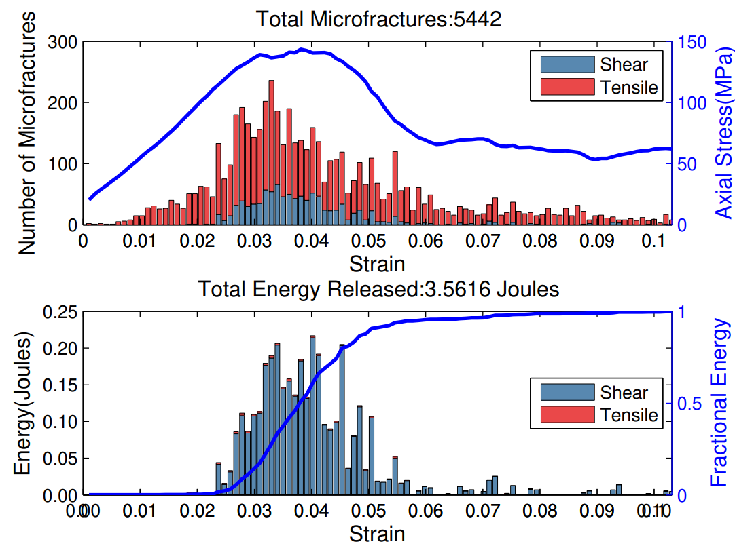

Energy associated with Microfracturing/ AE
Methods #2
$$E_{f}=\left(\frac{1}{2C_{f}}\right)σ_{cf}^{2}v_{f}$$
E_{f} = Energy of micro-fracture
C_{f} = Elastic Modulus (Pa)
σ_{cf} = Peak strength at microfracture growth
ν_{f} = volume of microfracture

Slide 10

Clustering and b-value
Methods #3
Source dimension: 0.0012 m
Each crack is assumed to be an expanding shear fracture
Propagates at 0.5*Vs
Vs of sandstone = 1500 m/s
Vs of granite = 3000 m/s
Strain rate: 1.2x10⁻⁷ m/s
Total axial Strain: 0.103
Event duration is
1.5% of total strain in sandstone
2.5% of strain in granite
Strain = 0.01
Event 1
Strain = 0.02
Strain = 0.03
Event 3
Strain = 0.07
< r
Event 2
Strain = 0.08
< r
> r
< r
Event 4
Spatial limit of r = 0.0012
Temporal limit of 0.02 Strain

Slide 11
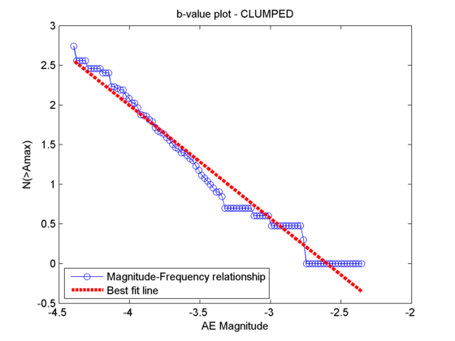


Clustering and b-value
Methods #3
$$M_{e}=\frac{2}{3}\log_{10}E_{f}−2.9$$
M_{e} = Seismic moment
AE events follow power law frequency-magnitude relationship
$$\log{N\left(M\right)=a −bM}$$
N= number of earthquakes greater than magnitude M
b = slope of frequency magnitude relationship
(Lockner, 1993)

Slide 12
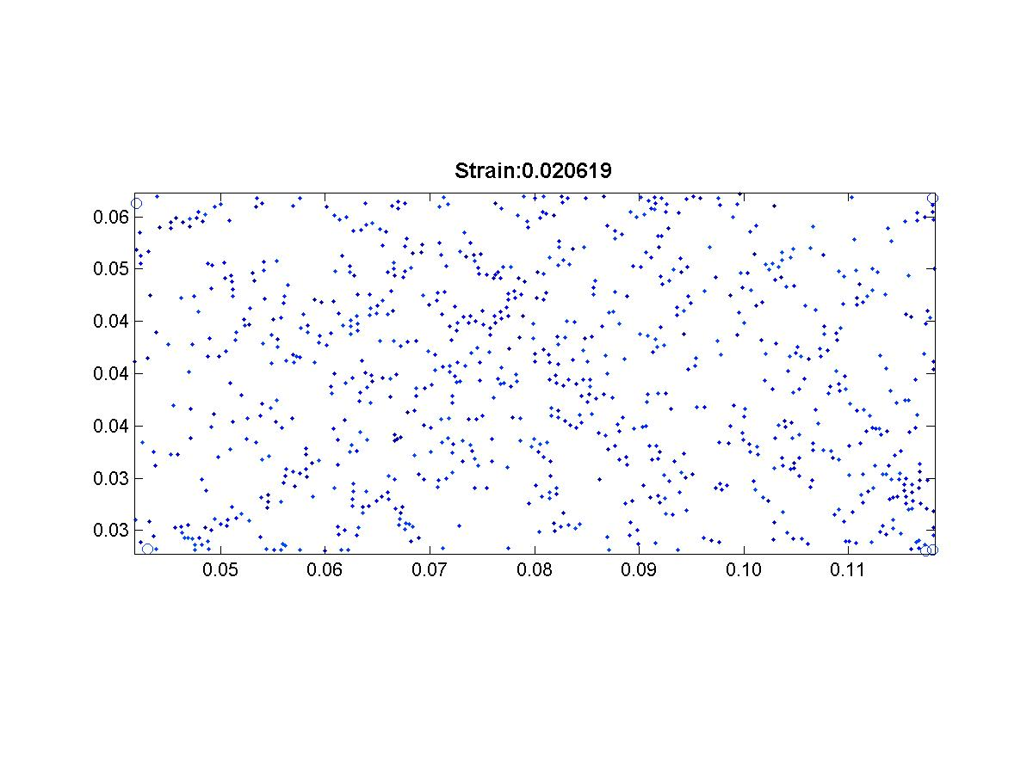
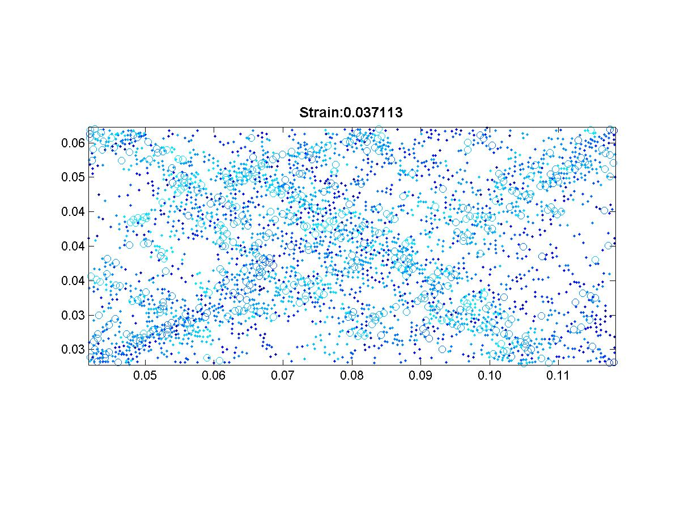
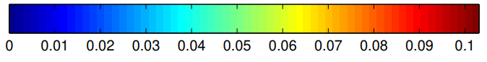
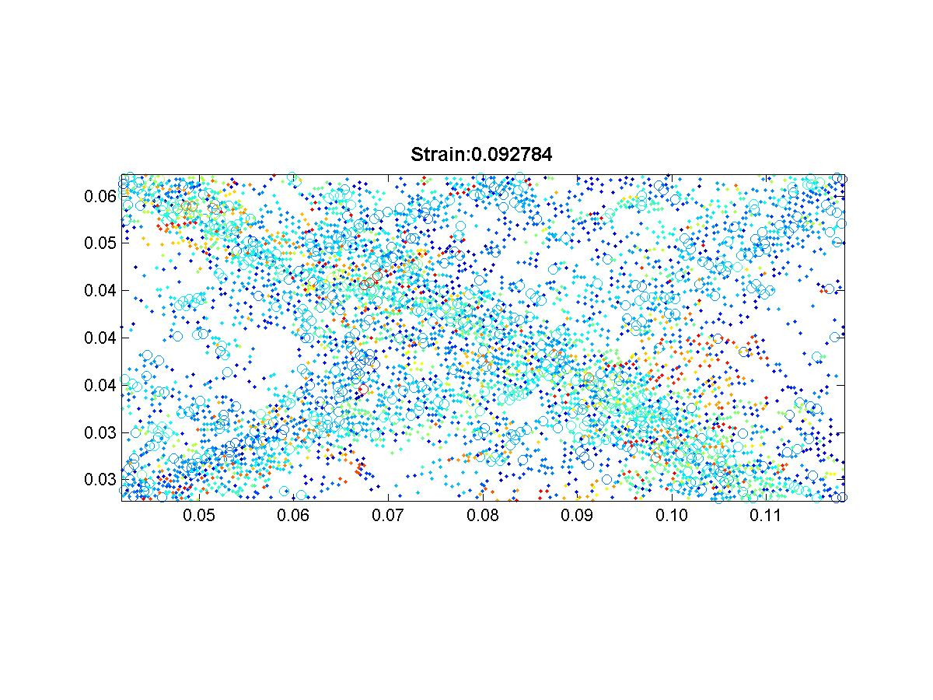
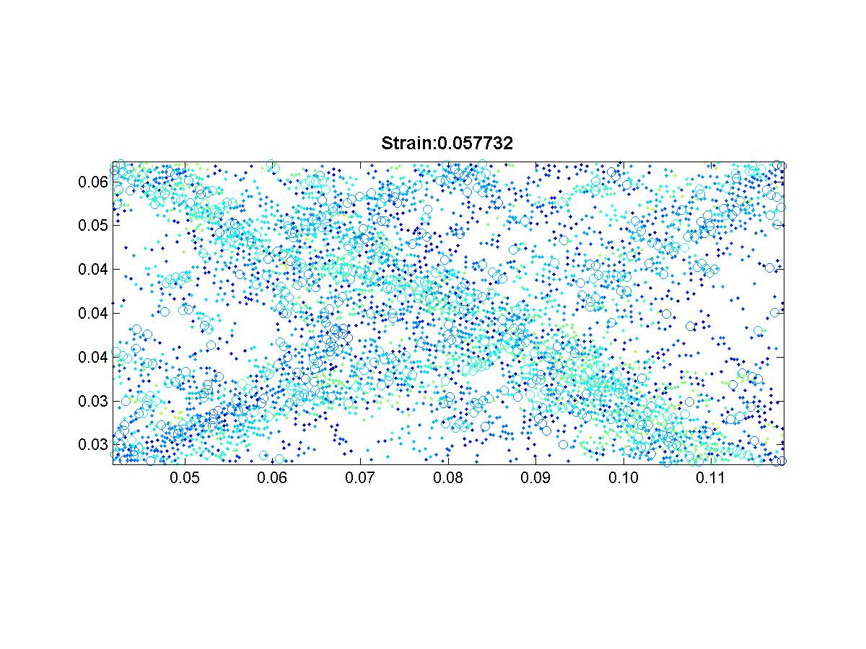
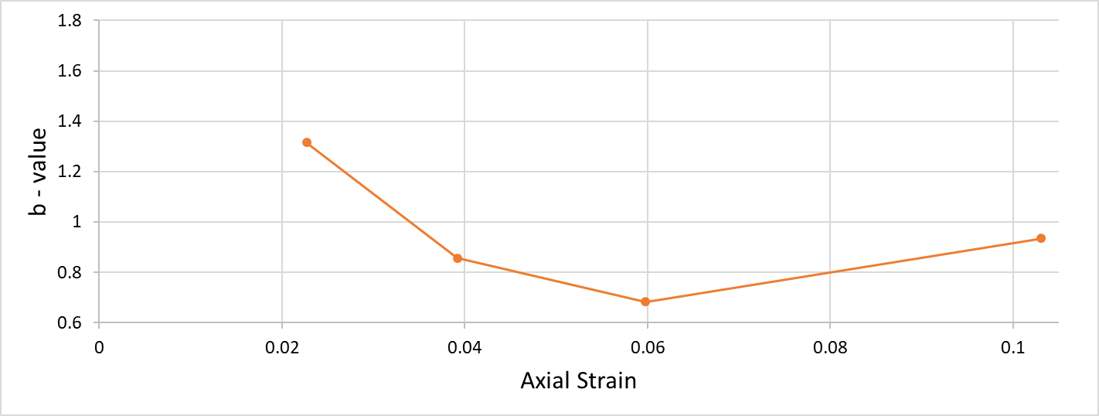
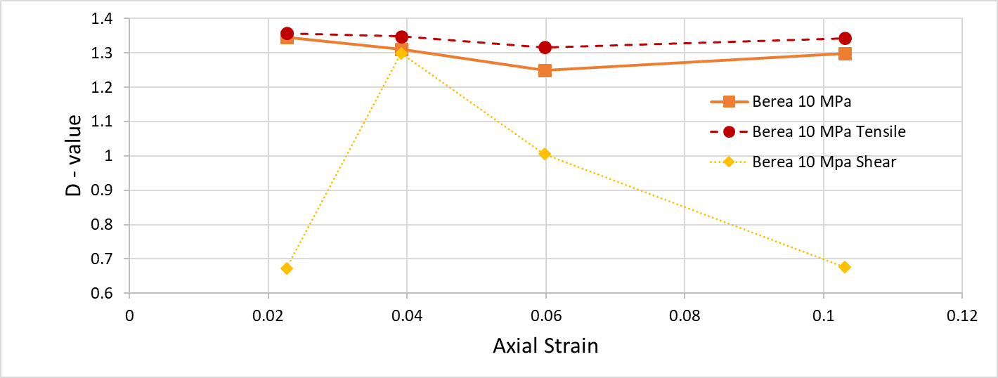
Results from Berea Sandstone
Confining = 10 MPa
1
2
2
1
3
4
3
4
1
4
1
2
3
2
4
3

Slide 13
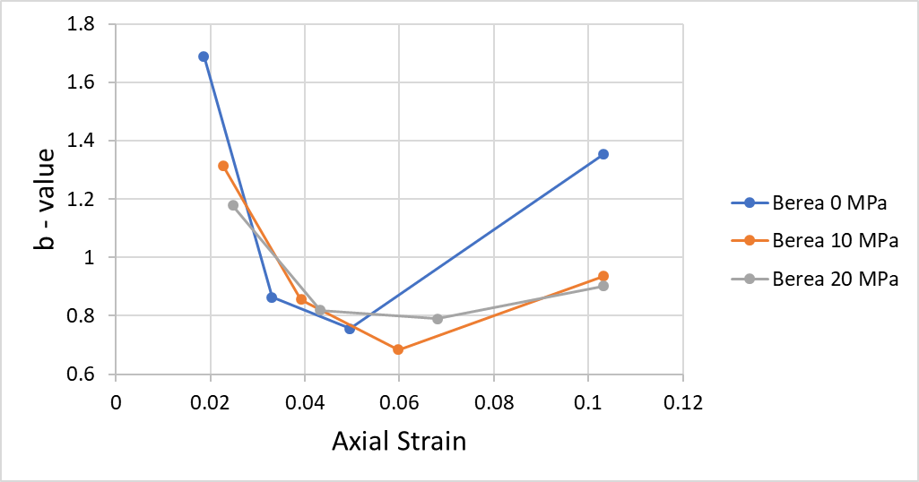
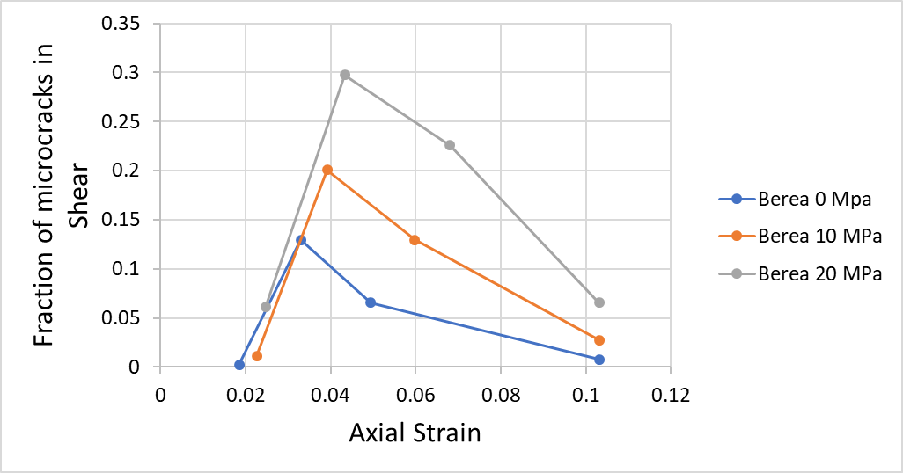
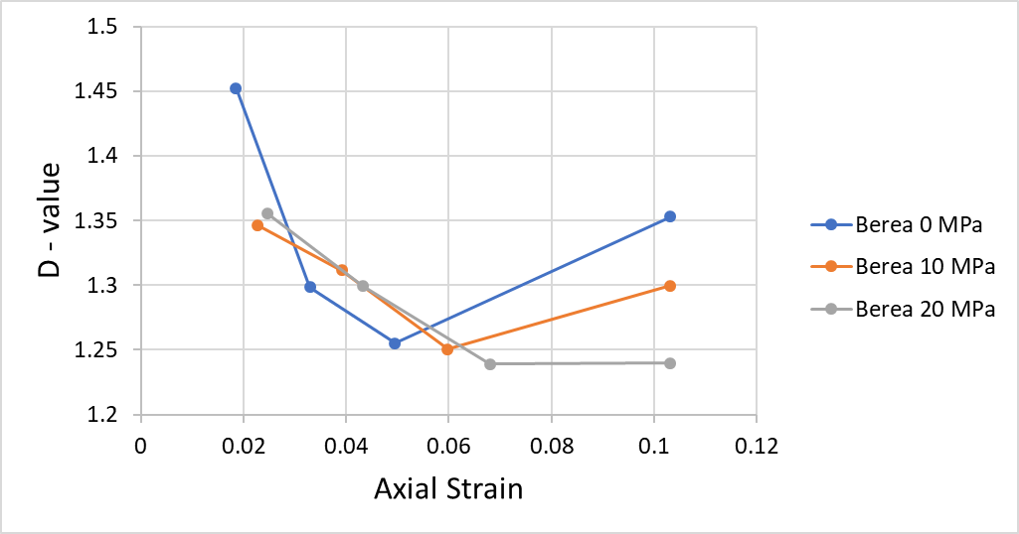
Results from Berea Sandstone
Thus, as we approach failure in soft rock:
Rapid Increase in microfracturing, especially shear
Decline in b-values
Decline in D-values

Slide 14
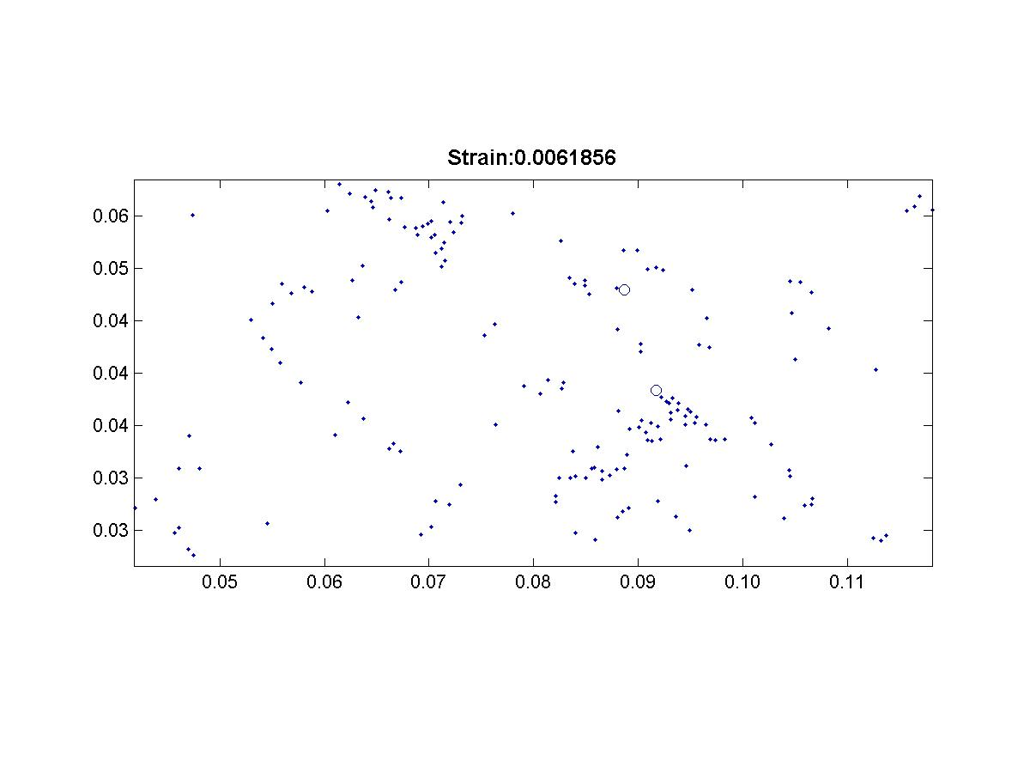
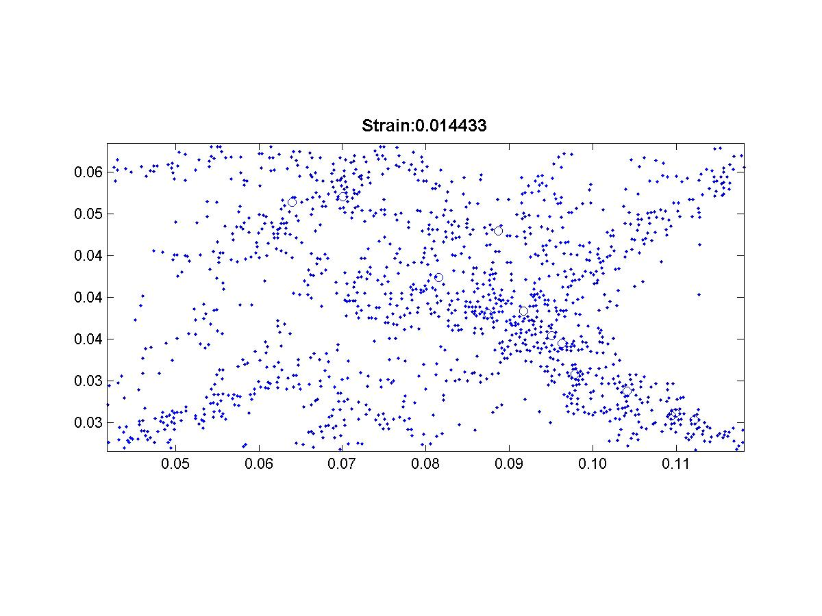
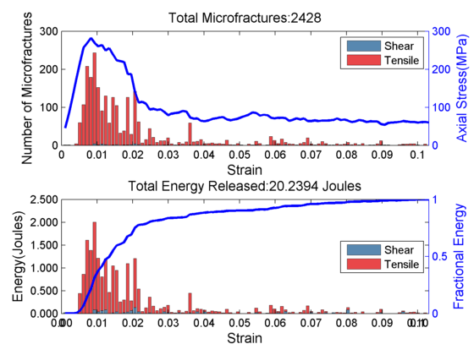
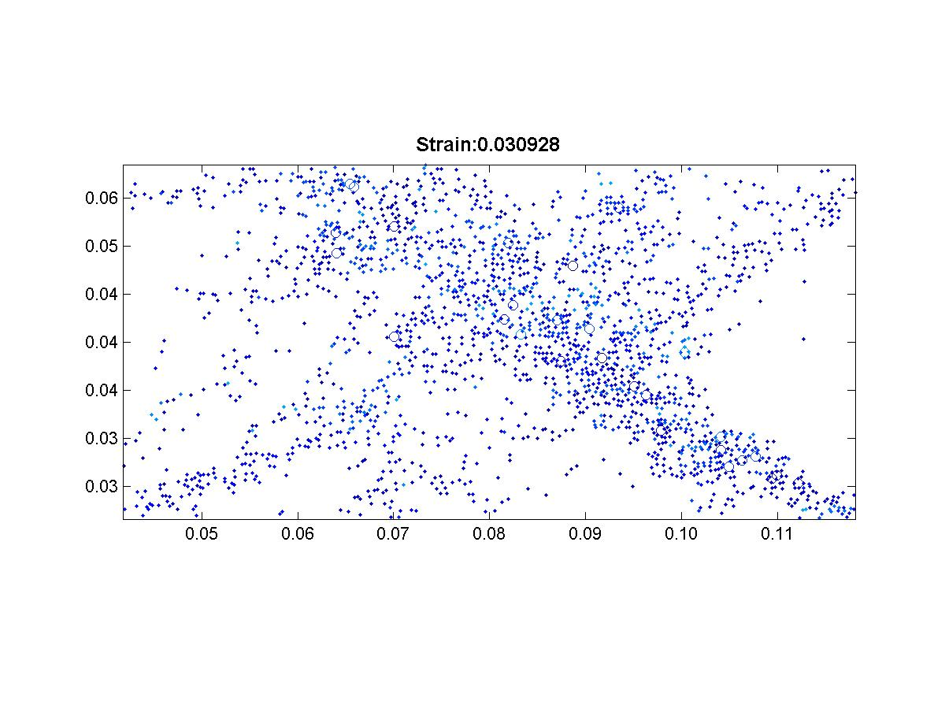
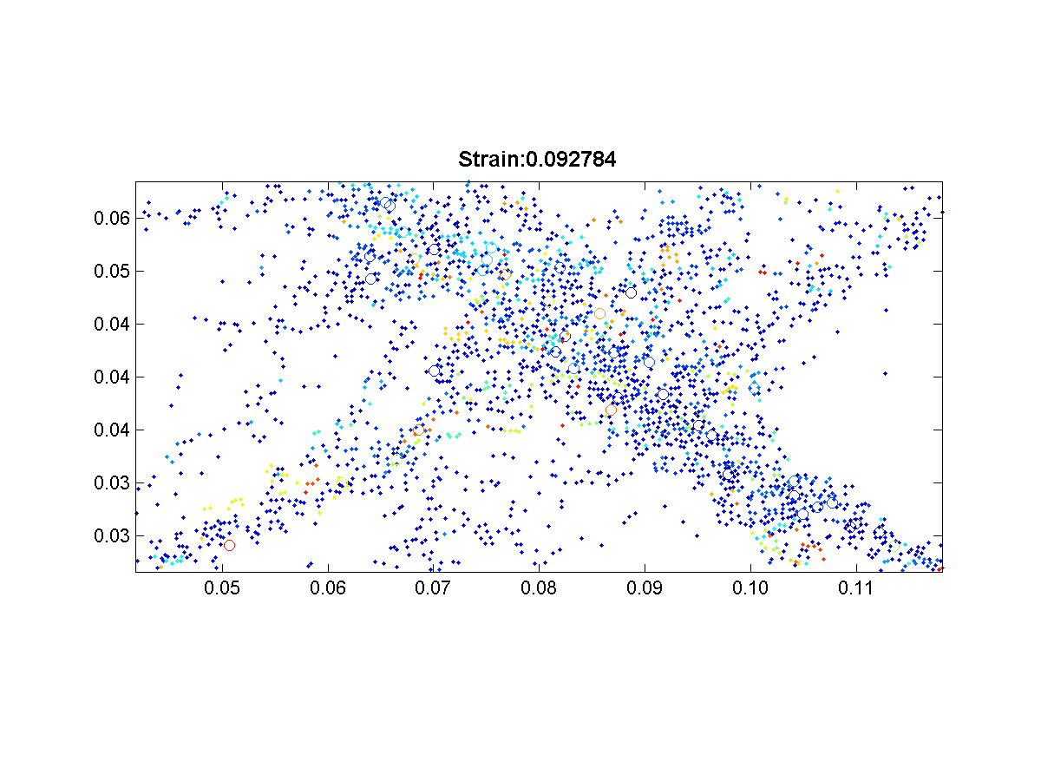
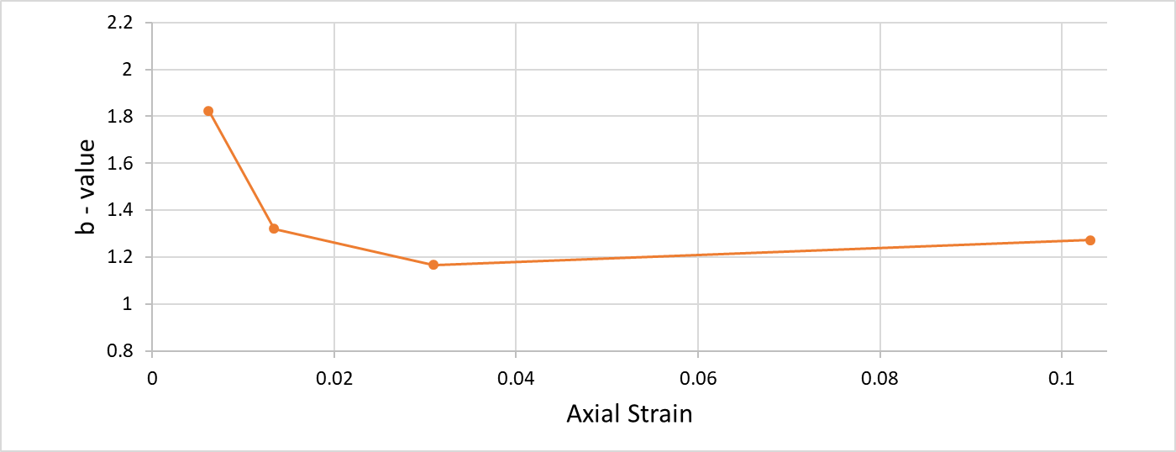
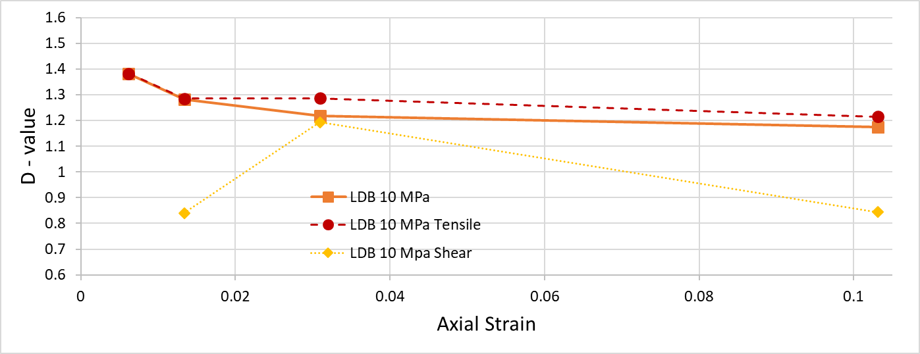
Results from Lac du Bonnet Granite
1
2
2
1
3
4
3
4
1
1
2
3
4
2
4
3

Slide 15
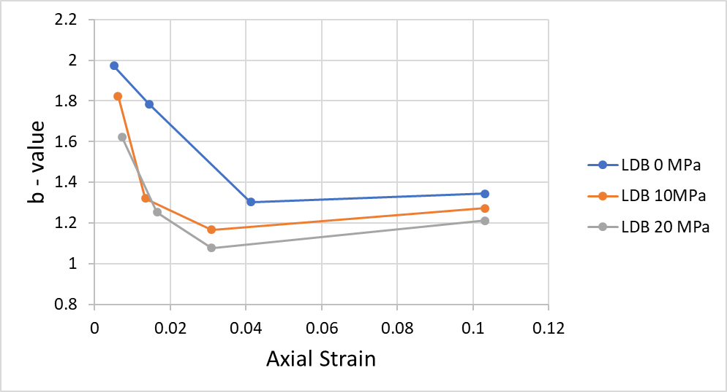
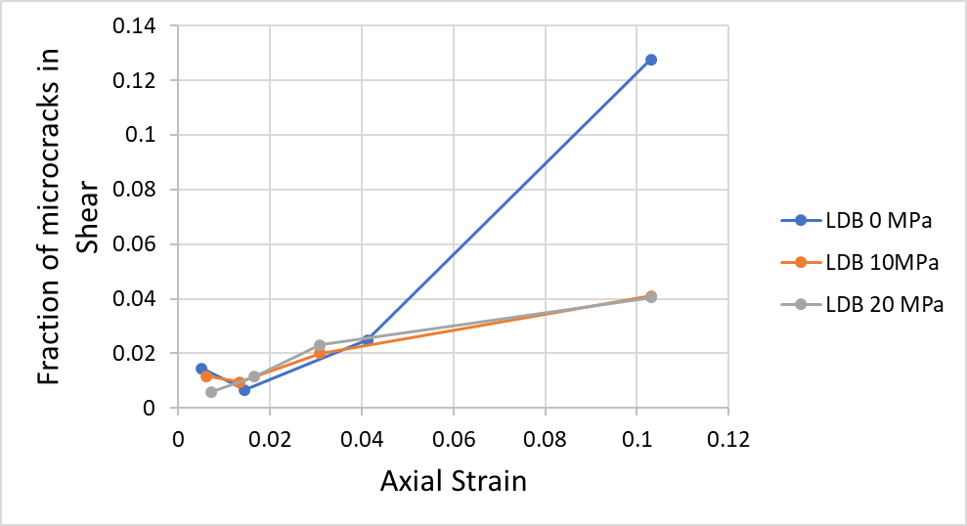
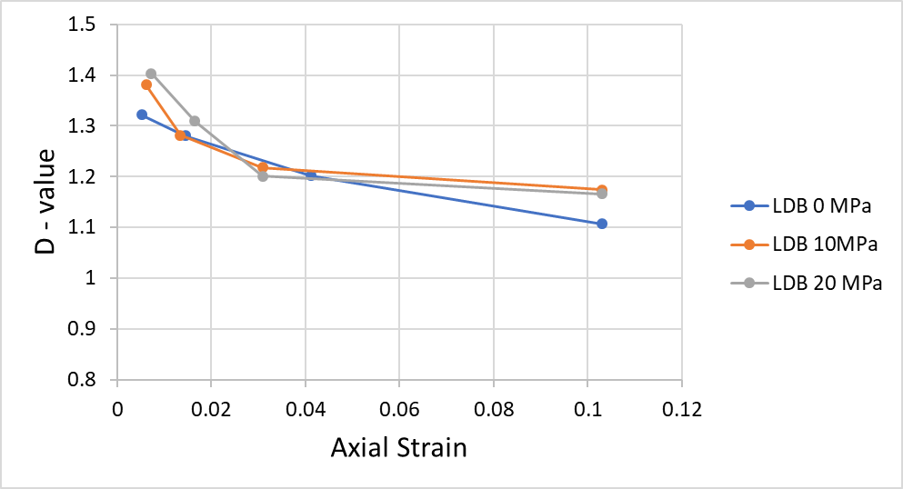
Results from Lac du Bonnet Granite
Thus, as we approach failure in hard rock:
Rapid Increase in microfracturing, especially shear
Decline in b-values
Decline in D-values

Slide 16
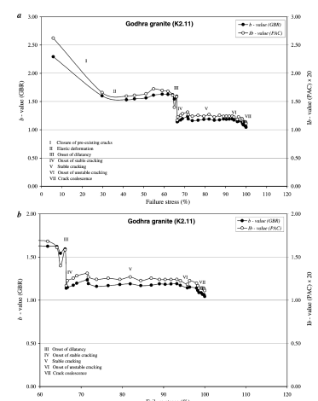
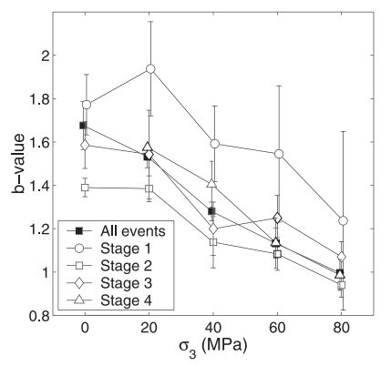
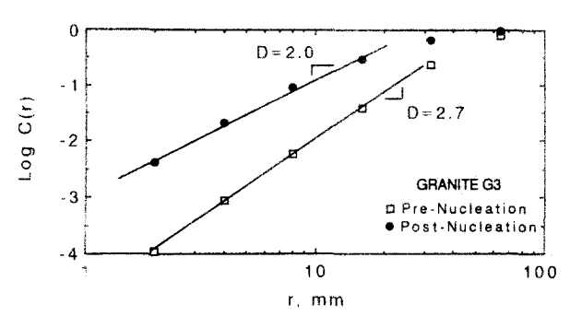
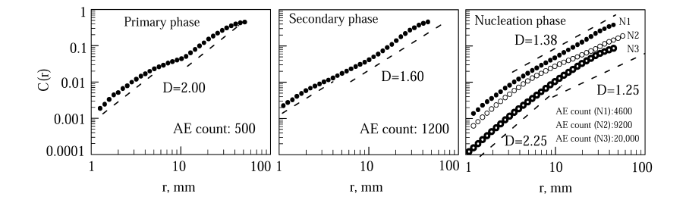
Validation from laboratory experiments
Amitrano, 2003
Lockner, 1993
Rao and Lakshmi, 2005
Lei et al., 2004

Slide 17
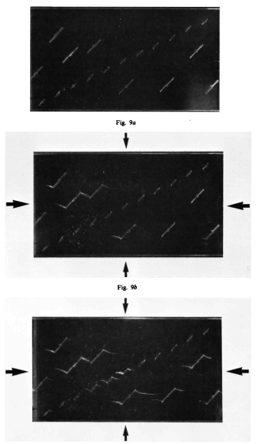
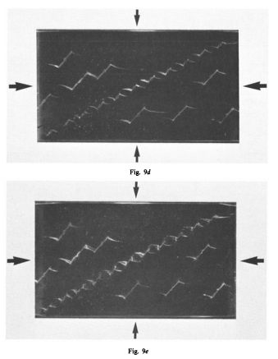
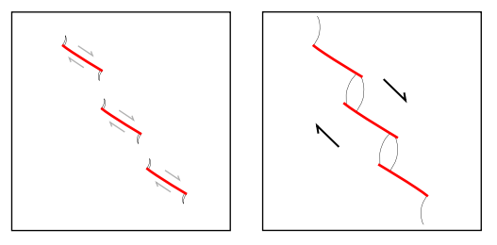
A mechanistic approach
Blenkinsop, 2008
The growth of shear fractures results in:
localization of stress along its tips
Localized growth of tensile microfractures
Clustering, and decreased D-values
Horii and Nemat-Nasser, 1985

Slide 18
Summary of Precursory signatures
The coalescence of microfractures into a shear fracture involves:
Increase in microfracturing in shear
Decline in b-values
Decline in D-values
Hypothesis: The growth of shear fractures results in localization of stress along its tips, and subsequent growth of tensile wing cracks

Slide 19
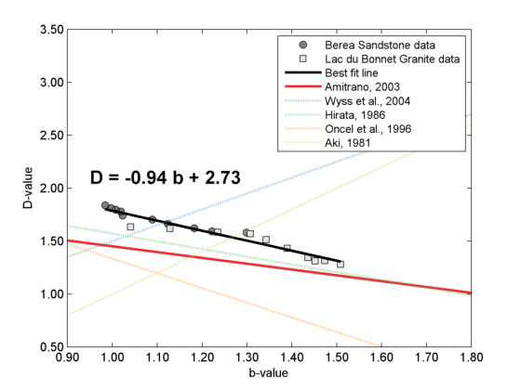
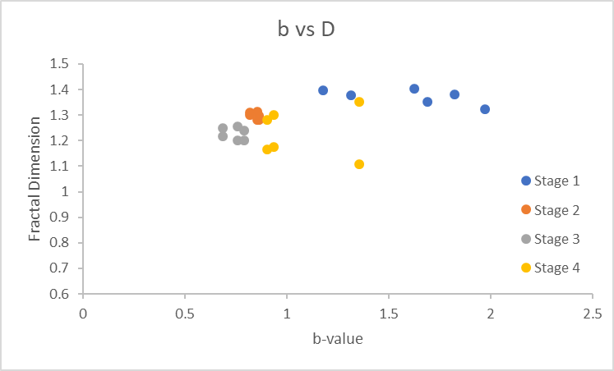
b-value and D-value
The relationship between b and D depends on what part of the deformation cycle they are measured

Slide 20
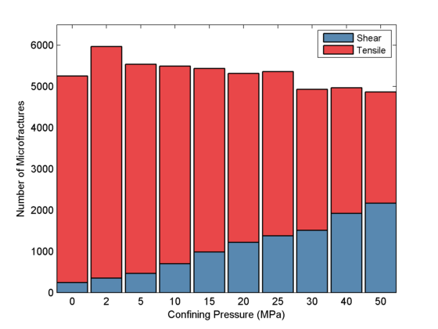
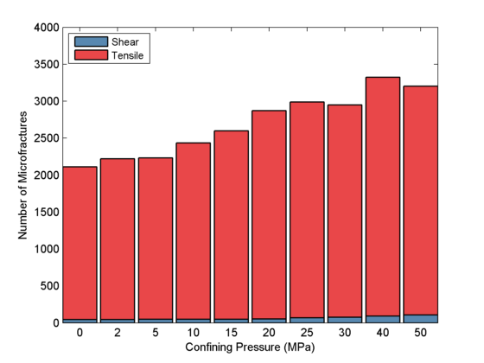
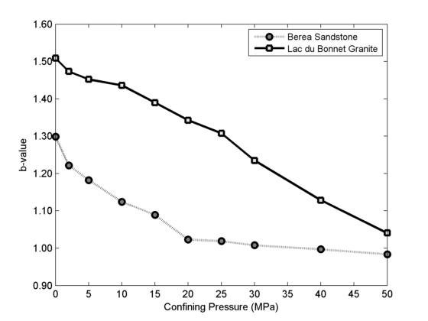
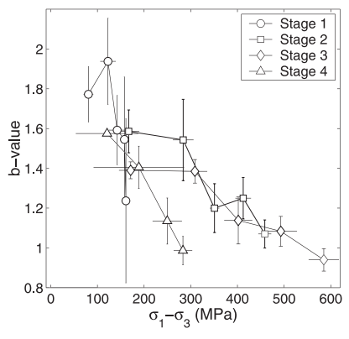
Effect of Confining Pressure
Berea Sandstone
Lac du Bonnet Granite
What does this mean for precursory signatures?
Amitrano, 2003

Slide 21
Future Work
Collect more data and new analyses
Stress and Force chains
Effect of confining pressure
Develop a conceptual framework linking b-value, D-value and microfracturing mode
Effect of event source radius for clustering on b-value
Can this be applied to earthquake prediction?

